Slide 1
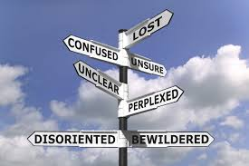
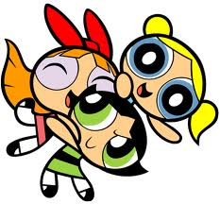
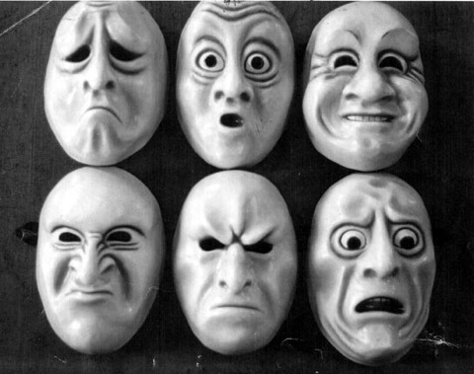
Emotional awareness and social support: Exploring the Links between Emotional Awareness and Social Support in Adolescence
Claire Rowsell, Joseph Ciarrochi, Frank Deane & Patrick Heaven
University of Wollongong
Wollongong , Australia
ABSTRACT
RESULTS
The purpose of this study was to investigate the longitudinal impact of emotional awareness and social support in adolescence. Emotional awareness has been linked to many well-being and positive mental and physical health outcomes. The present study investigated the relationships between emotional awareness and social support in adolescence. 903 (464 males; 439 females) students from five Australian high schools participated. Participants completed questionnaires annually from Grade 9 to Grade 12. Participants completed self-report measures of (1) emotional awareness, (2) social support network size and (3) quality of social support. Emotional awareness was associated with greater social support quality and network size. Cross-lagged structural equation modeling was utilized. Results provide preliminary evidence for a reciprocal relationship between emotional awareness and social support network size and quality throughout high school.
Correlations between emotional awareness and social support network size (r ranged between .08 to .29) and social support quality (r ranged between .19 to .34) were significant and small in magnitude.
Structural equation modeling
Mplus 6 was used for structural equation modeling to represent the association between emotional awareness and social support (network size and quality, separately). Maximum Likelihood parameter (MLR) estimates were used with standard errors and a chi-squared test statistic that are robust to non-normality.
The findings indicate that the factor structure of social support and emotional awareness are consistent over time, as are the autocorrelations and cross-lag paths. The cross-lags indicate that emotional awareness had a significant and positive effect on residual change in social support network size (β = .096, p < .001) and quality (β = .103, p < .001). In addition, social support network size (β = .055, p = .01) and social support quality (β = .115, p < .001) had a significant and positive effect on residual change in emotional awareness.
These findings provide evidence for a reciprocal influence between emotional awareness and both aspects of social support over high school. The reciprocal influence was consistent over time and gender.
Figure 1. Correlations between study variables.
Male crrelations along the top, female correlations along the bottom
*p < .05, **p < .01
INTRODUCTION
A three-year, four-wave longitudinal study was conducted to assess the direction of the association between emotional awareness and social support network size and quality during adolescence (Grade 9-12).
Social support
Social support is critical for development, psychological adjustment and well-being, particularly during adolescence (Fordham & Stevenson-Hinde, 1999; Helsen, Vollebergh, & Meeus 2000; Uchino, Cacioppo & Kiecolt-Glaser, 1996).
Emotional awareness
Emotional awareness is the ability to identify, label and describe one’s emotions (Ciarrochi, Heaven, & Supavadeeprasit, 2008). It is an important component of emotion regulation (Salovey, Mayer, Goldman, Turvey, & Palfai, 2002). Low awareness is associated with several detrimental well-being outcomes (e.g., Ciarrochi et al., 2008; Ciarrochi, Kashdan, Leeson, Heaven, & Jordan, 2010) and clinical disorders (e.g., Posse, Hallstrom & Backenroth-Ohsako, 2002; Wheeler, Greiner, & Boulton, 2005).
Figure 1. Factor loadings and paths invariant over time for emotional awareness and social support network size
*p ≤ .01, **p < .001
Figure 2. Factor loadings and paths invariant over time for emotional awareness and social support quality
**p < .001
DISCUSSION
Greater attunement with one’s emotions led to greater social support, while having greater network size and quality of social support predicted greater emotional awareness. These influences were consistent over time (Grade 9-12) and gender.
There are a number of possible explanations for why awareness is predictive of greater social support. Aware adolescents may have a greater capacity to soothe themselves and therefore, have less dependence on external supports. Those high in awareness may have better social skills, making them more appealing to others. Consequently they may develop connections with others more easily, leading to a larger social network. They may have the ability to develop healthy and intimate relationships with others and manage relationships, leading to more close connections with others and in turn, superior support.
Social support may increase emotional awareness in several ways. Supportive others may model labeling of emotions and emotional awareness skills. Interactions with supportive others may provide a space for self-expression of the adolescent’s, hence, increasing their emotional understanding. These support people may assist in clarifying the adolescents’ emotions. Finally, the support network may show acceptance of their own and the adolescent’s emotions, which may open the adolescent up to be more aware and curious of their own internal experiences.
Interventions aimed at increasing adolescents’ emotional (e.g., identifying and labelling emotions) and social skills (e.g., how to access appropriate social support) could improve emotional regulation and well-being. There are several mindfulness-based therapies that may be beneficial for developing emotional awareness and improving interpersonal effectiveness, such as Acceptance and Commitment Therapy (ACT) and Dialectical Behaviour Therapy (DBT).
METHOD
Participants
Participants were 903 (464 males; 439 females) high school students from five high schools in a Catholic Diocese of New South Wales, Australia, specifically in the Wollongong and South-Western Sydney area. Students completed questionnaires on emotional awareness and social support network size and quality annually for three years, from Grade 9 to Grade 12.
Measures
Emotional Awareness.
Toronto Alexithymia Scale (Bagby, Parker, & Taylor, 1994)
Perceived social support network size and quality.
4-item version of the Social Support Questionnaire (SSQ; Ciarrochi & Chan, 2001; Sarason, Levine, Basham, & Sarason, 1983)
ACKNOWLEDGMENTS
REFERENCES
I would like to thank Dr. Joseph Ciarrochi, Dr. Patrick Heaven, Dr. Frank Deane, Dr. Linda Bilich, and the Illawarra Institute of Mental Health for their help with this study.
Bagby, R. M., Parker, J. D. A., & Taylor, G. J. (1994). The twenty-item Toronto Alexithymia Scale- I. Item selection and cross-validation of the factor structure. Journal of Psychosomatic Research, 38, 23-32.
Ciarrochi, J. & Chan, A. B. J. (2001). Measuring emotional intelligence in adolescents. Personality and Individual Differences, 31, 1105-1119. doi: 10.1016/S0191-8869(00)00207-5
Ciarrochi, J., Heaven, P. C. L., & Supavadeeprasit, S. (2008). The link between emotion identification skills and socio-emotional functioning in early adolescence: A 1-year longitudinal study. Journal of Adolescence, 31, 565-582.
Ciarrochi, J., Kashdan, T. B., Leeson, P., Heaven, P., & Jordan, C. (2010). On being aware and accepting: A one-year longitudinal study into adolescent well-being. Journal of Adolescence, 1-9, doi: 10.1016/j.adolescence.2010.09.003
Fordham, K., & Stevenson-Hinde, J. (1999). Shyness, friendship quality, and adjustment during middle childhood. The Journal of Child Psychology and Psychiatry, 40, 757-768. doi: 10.1111/1469-7610.00491
Helsen, M., Vollebergh, W., & Meeus, W. (2000). Social support from parents and friends and emotional problems in adolescence. Journal of Youth and Adolescence, 29, 319-336.
Posse, M., Hallstrom, T., & Backenroth-Ohsako, G. (2002). Alexithymia, social support, psycho-social stress and mental health in a female population. Nordic Journal of Psychiatry, 56, 329-33.
Salovey, P., Mayer, J. D., Goldman, S. L., Turvey, C., & Palfai, T. P. (2002). Emotional attention, clarity, and repair: Exploring emotional intelligence using the trait meta-mood scale. In J. W. Pennebaker (Ed.), Emotion, disclosure, and health (pp. 125-154). Washington, DC: American Psychological Association.
Sarason, I. G., Levine, H. M., Basham, R. B., & Sarason, B. R. (1983). Assessing social support: The Social Support Questionnaire. Journal of Personality and Social Psychology, 44, 127-139.
Uchino, B. N., Cacioppo, J. T., & Kiecolt-Glaser, J. K. (1996). The relationship between social support and physiological processes: A review with emphasis on underlying mechanisms and implications for health. Psychological Bulletin, 119, 488-531.
Wheeler, K., Greiner, P., & Boulton, M. (2005). Exploring alexithymia, depression, and binge eating in self-reported eating disorders in women. Perspective in Psychiatric Care, 41, 114-123.

